Slide 1

Thulani Manthanee Wickramasinghe 2136657 BSc(Hons) Computer Science And Software Engineering
CIS007-3 Comparative Integrated Systems
Project- 2022

Slide 2
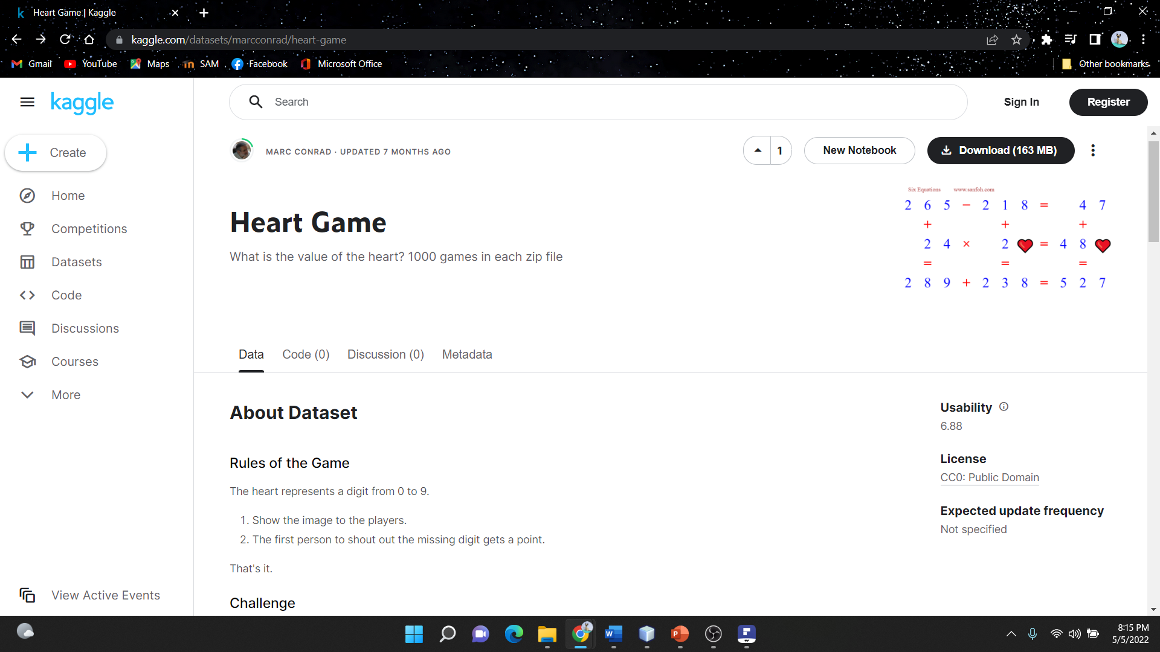
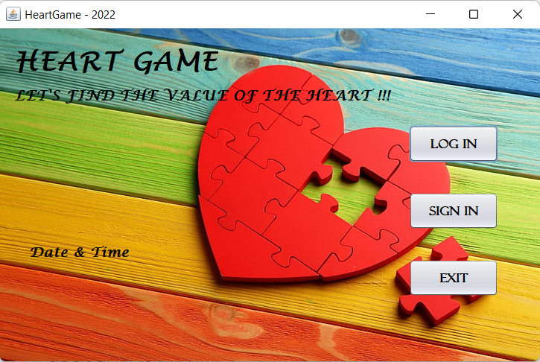
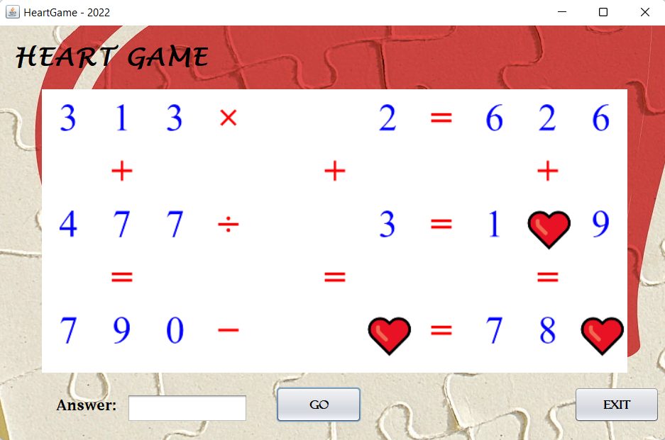
HEART GAME
https://www.kaggle.com/marcconrad

Slide 3

THEMES TO REFLECT ON
EVENT-DRIVEN PROGRAMMING
VIRTUAL IDENTITY
INTEROPERABILITY
OBJECT ORIENTATION
INTERESTING FEATURES

Slide 4

EVENT-DRIVEN PROGRAMMING
Button click event
Mouse move event
Mouse click event
VIRTUAL IDENTITY
User credential
(playerID, Username, Password)
OBJECT ORIENTATION
Polymorphism
Inheritance
INTEROPERABILITY
World time API - http://worldtimeapi.org/
INTERESTING FEATURES
text to voice assistance
(When clicking the button, it changes the text into voice By using an external plugin free text to speech (freetts))

Slide 5
THANK YOU.

